Slide 1
Discover St Louis
Data Analytics Project 1
Rori Cooper, Rebecca Kalhorn, Raj Sikka
Using public data to show the distinctive neighborhood characteristics of St. Louis City.

Slide 2
Challenges
Narrowing down data to consider
Finding data
Data delineated by different factors (Tracts, Neighborhoods, Zip Codes)

Slide 3
Challenges: Narrowing Down Data to Consider
Areas
Businesses
Education
Crime
Income

Slide 4
Challenges: Narrowing and Finding Data
Businesses (JSON)
Yelp
Education (Jupyter Notebook and CSV Files)
National Center for Educational Sciences (NCES) – (https://nces.ed.gov/ccd/schoolsearch/ and https://nces.ed.gov/surveys/pss/privateschoolsearch/).
Crime (Jupyter Notebook and CSV Files)
City of St. Louis Open Statistics (https://www.stlouis-mo.gov/data/)
Income/Population (Excel)
2010 Census and 2016 est (Home Mortgage Disclosure Act from www.stlouis-mo.gov)

Slide 5
Tracts, Neighborhoods and Zips, Oh My
Notes:
Only included zips fully contained in city limits

Slide 6
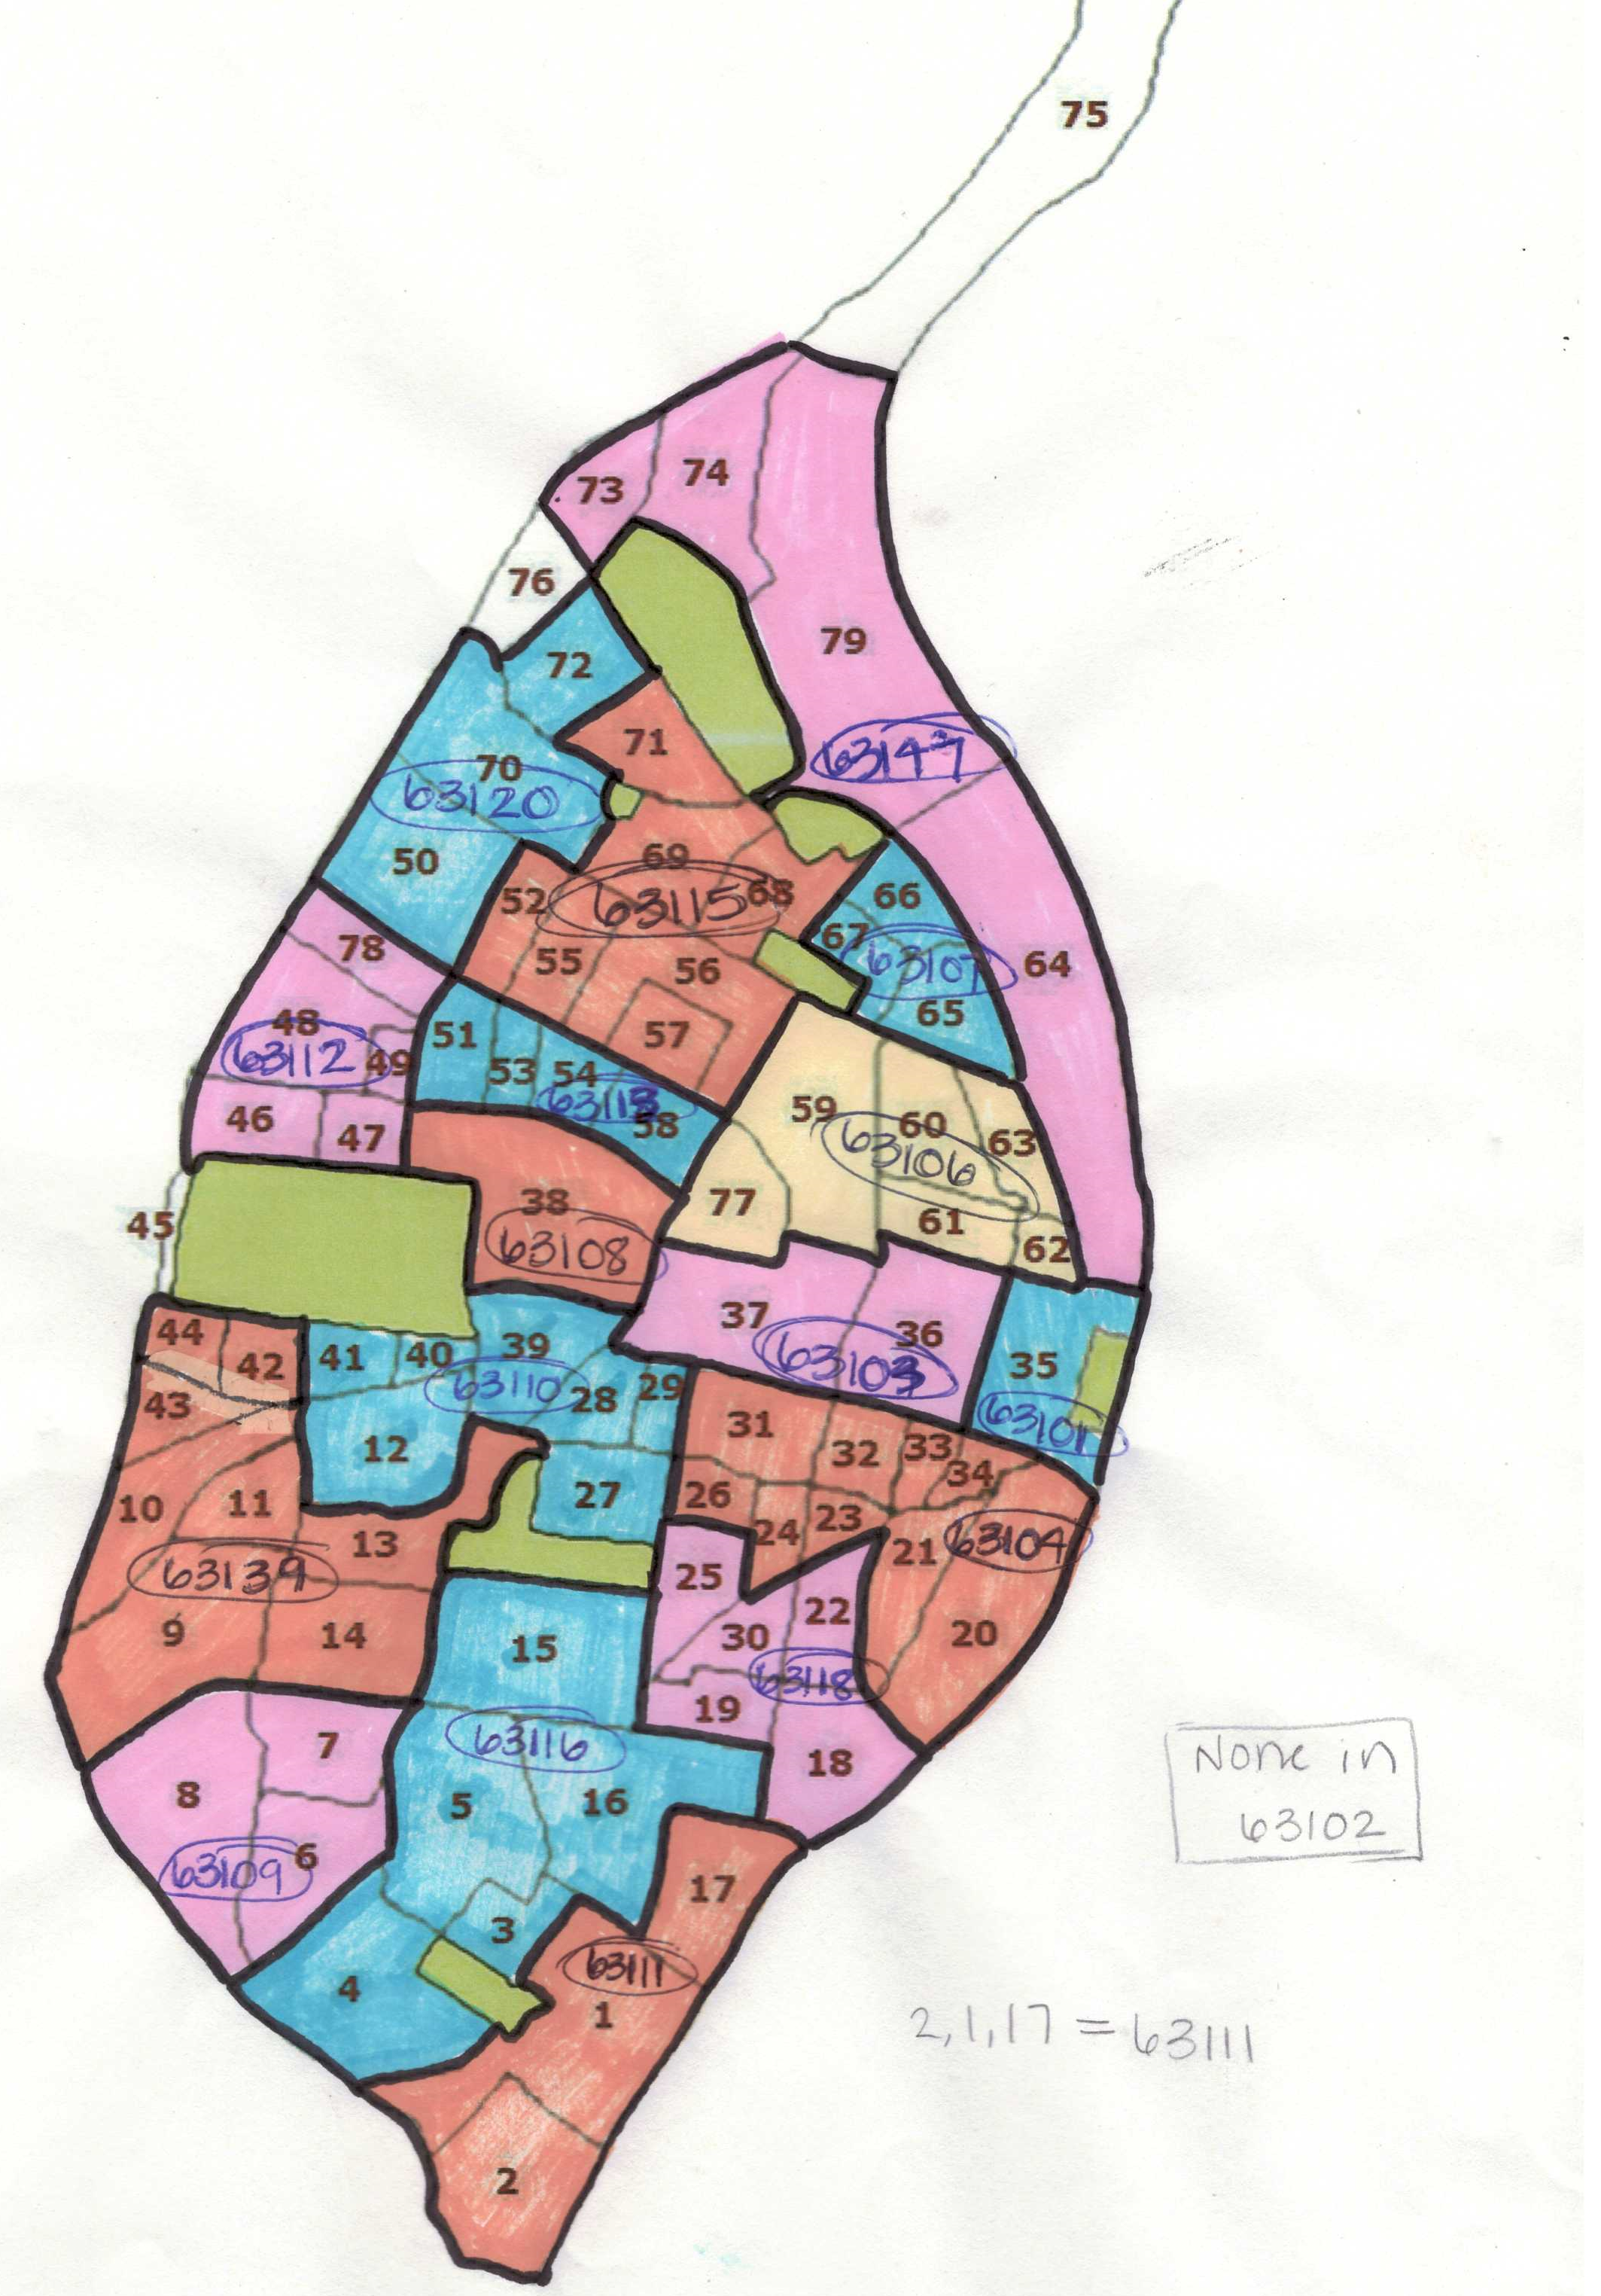
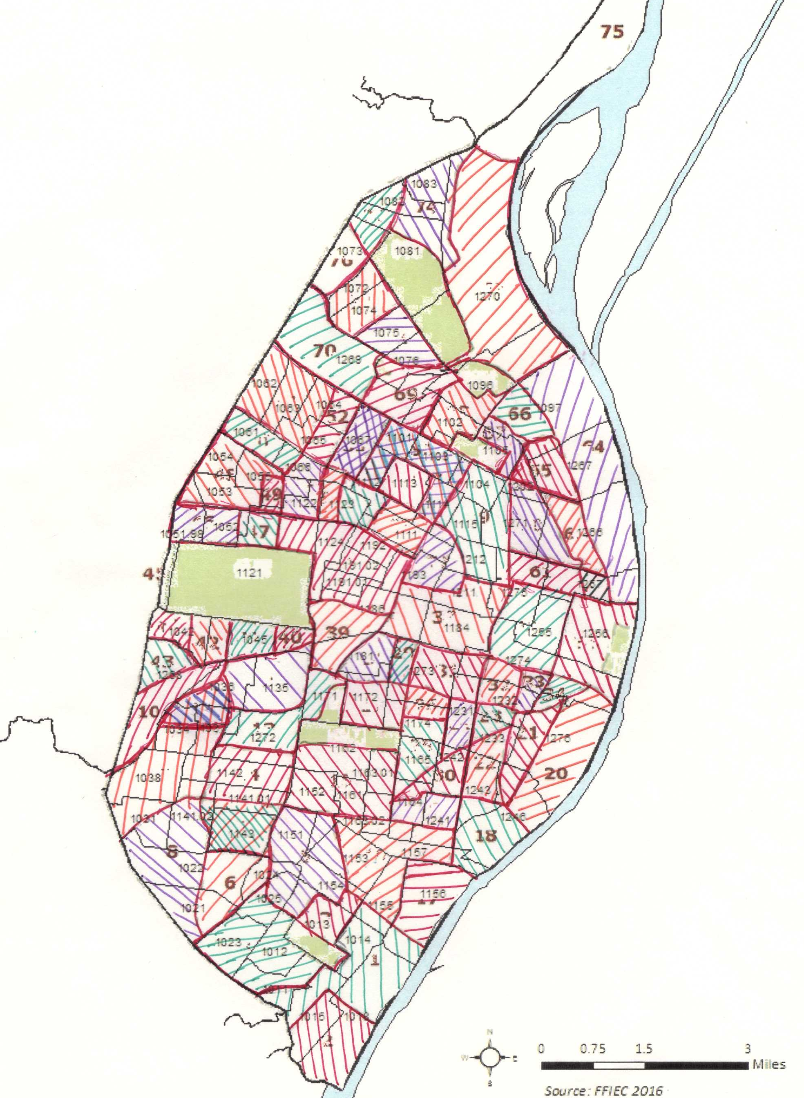
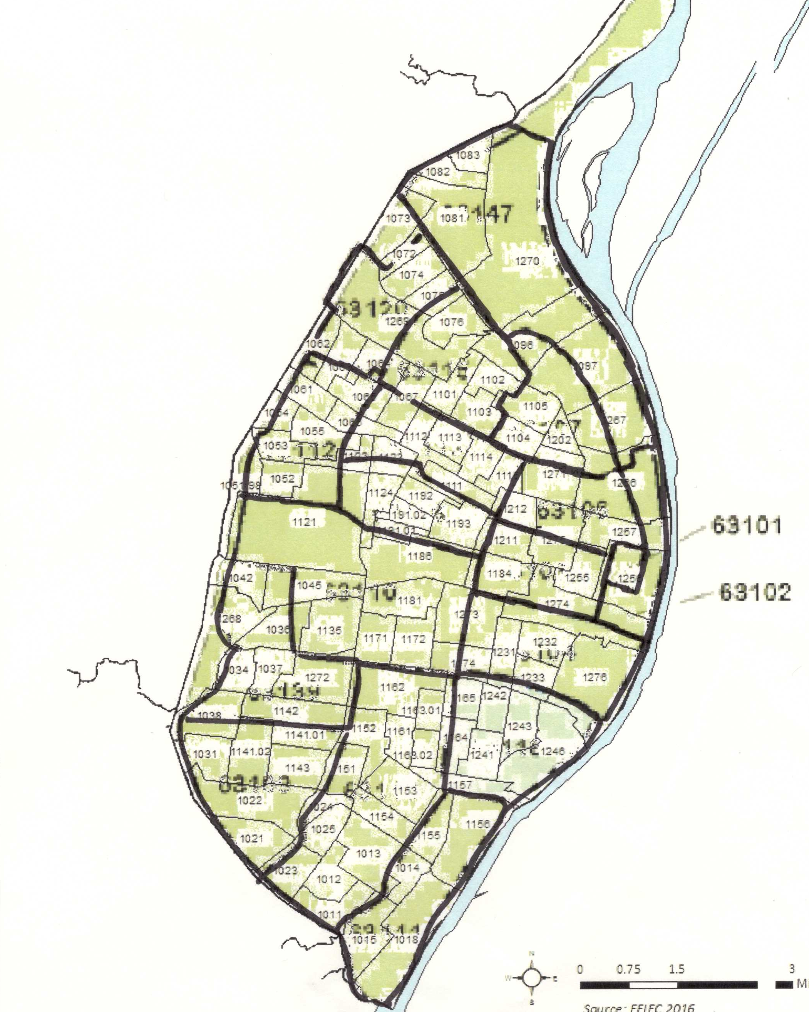
Challenges: Find Relationships
Neighborhoods and Zip Codes
Neighborhoods and Tract
Tracts and Zips Codes

Slide 7
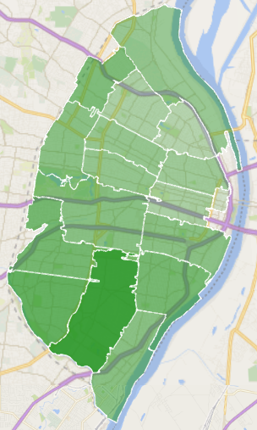
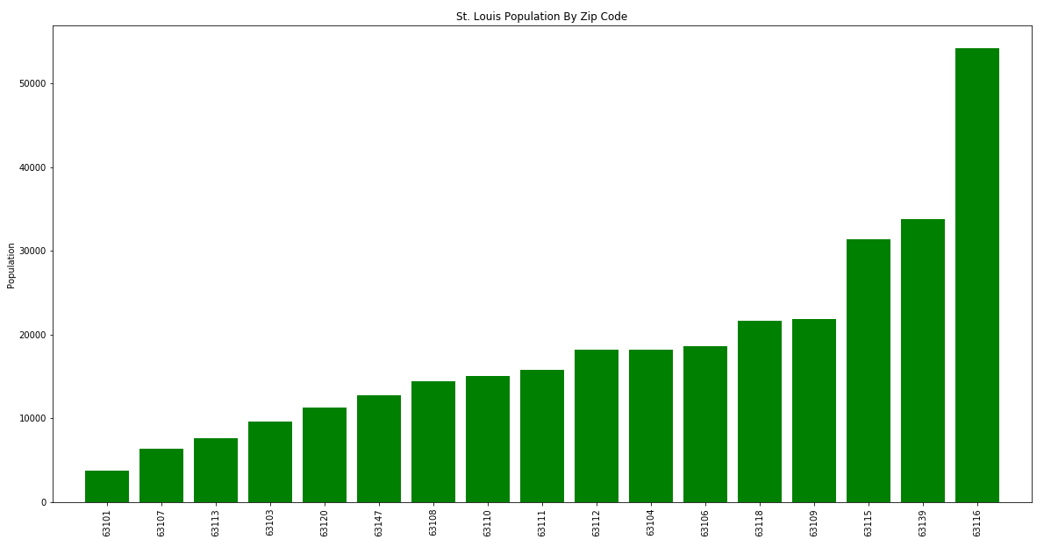
Population by Zip
The sum of population of tracts in each zip code.

Slide 8
The Project Approach
Data Gathering
Request sent via Postman to Yelp
Response captured in JSON format.
Data Processing
Reviewed the JSON file and finalized the Business Categories
Data Visualizations
Converted the CSV files to Data Frame using Pandas
Generated the necessary Bar Charts using Matplotlib
Process JSON file using Python and generated a CSV file for each business Category
The objective was to gather the data related to the number of Businesses categories (see the list below) present in St Louis City. The analysis would provide a snap shot to an individual when he/she is checking out a particular area with the intend to live or visit.
Food (Fast Food Joints, Restaurants)
Stores(Department, Grocery, Gas)
Financial Institutions (Banks, Loans etc.)
Hospitals, Urgent Care Centers
Universities/Colleges, Daycare Centers
Hotels, Bed & Breakfast
Data Analysis Tools Used
Postman
Yelp
JSON
Python
Matplotlib
Pandas
Excel

Slide 9
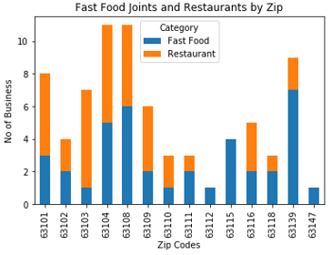
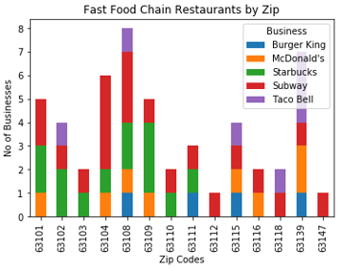
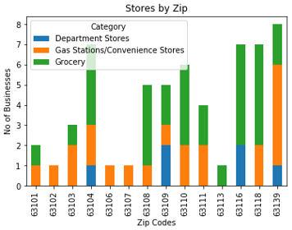
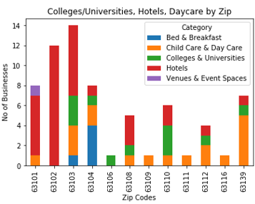
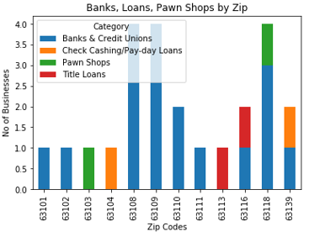
Business - Data Visualizations

Slide 10
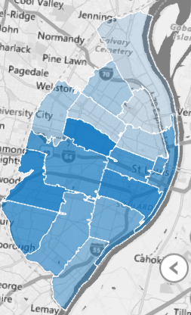
Challenges, Take a ways
Challenges:
When sending a Business request via postman. Yelp had limitations to providing only 50 responses (max limit) Had to send multiple requests to obtain the required data.
In some cases I had to customize the python code to accommodate the categories within the JSON file as they were not uniform.
Same businesses spelt in JSON response with different formats. Had to customize the code to accommodate it.
Takeaways
Learnt a how to apply the Data Analytics skills obtained so far in this project.
Plan to have a strategy when trying to pull the data. I plan to look into Google’s Geo locator for conducting Business search.
I plan to do the following to improve the current solution by doing the following
Expanding the Data Visualizations by using maps.
Providing a rating module which will assist in providing a rating for each zip code.

Slide 11
Education
Variety of School Types Available
Student Enrollment by Type and Zip Code
Student to Teacher Ratios by Type and Zip Code

Slide 12
Variety of School Types
Enrollment per School Type
3 school choices for St. Louis families:
67 public
29 charter
26 private

Slide 13
Student Enrollment by Type and Zip Code
Over 38,000 students enrolled in St. Louis Charter, Private, & Public Schools.
Zips with highest enrollment:
63110 (10 schools)
63139 (14 schools)
63106 (13 schools)
63104 (18 schools)
Notes:
63110 – Cheltenham, The Hill, Shaw, Botanical Heights, & Forest Park Southeast.
63139 –Hi-Pointe, Franz Park, Clifton Heights, Southwest Garden, & Northhampton.
63106 – St. Louis Place, Old North St. Louis, Carr Square, & Columbus Square.
63104 – The Gate, Lafayette Square, Compton Heights, Fox Park, McKinley Heights, Soulard, & Kosckuisko.

Slide 14
Student to Teacher Ratios by Type and Zip Code
Zips with lowest ratios:
63103 (1,520 students)
63108 (2,190 students)
63104 (4,103 students)
Private Schools report the lowest ratios.
Notes:
63110 – Cheltenham, The Hill, Shaw, Botanical Heights, & Forest Park Southeast.
63139 –Hi-Pointe, Franz Park, Clifton Heights, Southwest Garden, & Northhampton.
63106 – St. Louis Place, Old North St. Louis, Carr Square, & Columbus Square.
63104 – The Gate, Lafayette Square, Compton Heights, Fox Park, McKinley Heights, Soulard, & Kosckuisko.

Slide 15
School Types by Zip Code
No schools of any type identified in 63101 (Downtown) and 63102 (Riverfront and Gateway Arch).
63109 is unique because more students are enrolled in private schools than public. No charter schools were identified in this zip code.
63103 is unique because no students were enrolled in public or private schools. 100% of the students are enrolled in charter schools in this zip code.
63147 is unique because no students were enrolled in charter or private schools. 100% of the students are enrolled in public schools in this zip code.

Slide 16
Crime: Considerations
Original data from stlouis-gov.mo/data was given by neighborhood.
Crimes to consider
Violent Crimes
Non-Violent Neighborhood Crimes (i.e. stolen property, vandalism, drug abuse, etc)
Non-Neighborhood Crimes (i.e. forgery, embezzlement, etc)

Slide 17
Crime Counts By Type and Neighborhood

Slide 18
Crime Counts By Type and Zip Code

Slide 19
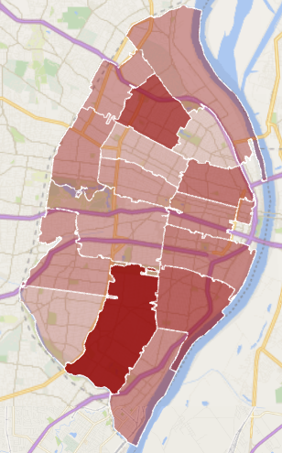
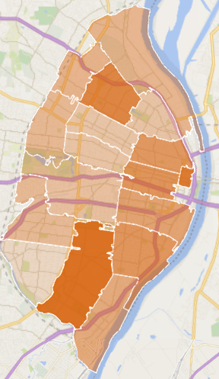
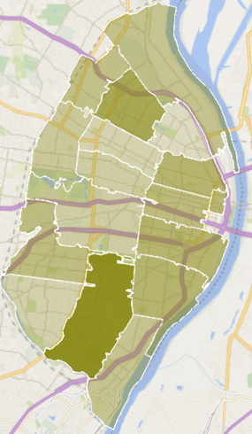
Crime Counts By Type and Zip Code
Violent Crimes Non-Violent Neighborhood Crimes Non-Neighborhood Crimes (i.e. stolen property, vandalism, drug abuse, etc) (i.e. forgery, embezzlement, etc)

Slide 20
Income: ~Median Income by Zip Code
The average of the median incomes by tract for each zip code.

Slide 21
Future Research/Next Steps
Ratings
Compare St. Louis to county and nation
Use other data
Google instead of Yelp
Other categories to consider
Home price
Home owners/renters
Diversity
Parks

Slide 22
Options to Continue Discovering St. Louis
Read - St. Louis City’s official website info https://www.stlouis-mo.gov/neighborhoods/
Listen - Local NPR Podcast http://www.welivehere.show/
Act - Local Meetup/Volunteer Community http://openstl.org/
We hope you enjoyed our presentation.
Thank you for your time!
Rori, Rebecca, and Raj

